Slide 1
Облачные Решения в Финансовом Секторе
Джамшид Абдумажитов
Менеджер по Облачным Решениям
Huawei Tech. Investment Tashkent

Slide 2



Global Digital Banking Transformation
Lower IT Cost
Open Ecosystem
Agile Business
Saving $15B IT Cost
for 2% RISC
Open API & Standard Platform
Fintech Applications
for Millions of Transactions

Slide 3







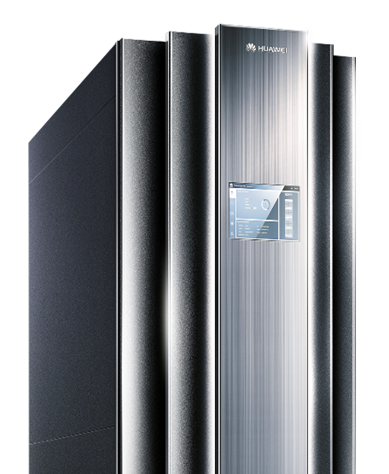


Financial Cloud Solution for Mission-Critical Services
Comprehensive banking modules
Componentized Structure
Highly Secure
Core Banking
Services
Multi-Channel
Services
FusionCloud
Open Cloud Management Platform
Bare-metal support
50% TCO saving
CPU hot-swappable
Auto scaling
10x ↑ efficiency
3rd party support
Mission Critical
Physical Resources
Virtualization
Resources

Slide 4

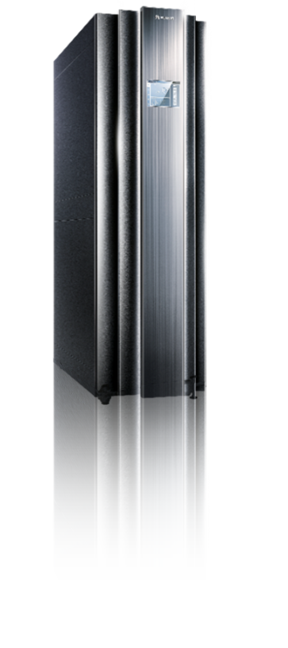







32S x86 Mission Critical Server KunLun
Extreme Performance
High Reliability
Open Ecosystem
PFAE
Error
OS
Data
HANA
DB2
(released in SPEC official website)
Notes:
针对企业对x86开放平台高性能、高可靠的需求，我们研发了全球首款32路开放架构关键业务服务器，帮助企业摆脱束缚，释放业务增长潜力。
通过Node controller互联芯片技术，KunLun最大支持32颗E7 v3 CPU互联，突破互联极限；同时KunLue是业界唯一支持物理与逻辑分区特性的16P+开放平台，实现了最大化的资源利用率；
其次，KunLun拥有PFAE主动故障分析引擎，主动预测风险部件，业界唯一CPU和内存在线热维护和KLPar多分区技术的运用，使得故障不会跨分区扩散，可靠性提升30x，降低85%宕机概率；
更重要的是，KunLun平台兼容主流x86操作系统、数据库和虚拟化技术。平台开放避免了封闭带来采购维护成本高，TCO相比superdome 2降低30%，相比Power 780降低50%。
KunLun已在金融OLTP、数据分析、SAP HANA和高性能计算应用场景发挥了亮眼的作用。

Slide 5


Infosys Finacle on Huawei FusionCloud Testing by EY
Key Index | Test Result
TPS during peak hours | 627.66
Average transaction response time (microsecond) | 408.95
Branches 6007
Tellers
20,335
Cloud host CPU usage | Application server | 17.04% – 32.02%
 | J-App | 31.18%
 | C-App | 11.53% – 49.81%
 | Database server | 9.14%
Clients
33million
Accounts>61 million
Transactions
121million
This report is audited by E&Y in Shanghai, March 2016
Notes:
1. The Infosys Finacle Core Banking Solution (version: 10.2.14) runs on Huawei servers at the Web, JEE, application, and database layers.
2. The online transaction processing test was carried out on the Huawei server & storage infrastructure setup, including 2 virtual web servers, 4 virtual JEE servers, 4 virtual application servers, and 1 physical database server

Slide 6







Outlook for FSI Cloud
FSI Cloud 2.0
FSI Cloud 3.0
FSI Cloud 1.0
Mission-critical on Cloud
Cloud Native
Internet App on Cloud
Mission
critical
Traditional
Internet
Mission
critical
Traditional
Internet
Traditional
Internet
Big Data
PaaS
Big Data
OpenStack
OpenStack
OpenStack
Computing
Storage
Networking
Physical
Virtualization
Physical
Virtualization
NOW
Future
Mission
Critical
Internet
FusionCloud

Slide 7








































300+ Financial Customers, including 6 of Top10 Banks

